Slide 1
Spanning tree-based multivariate spatial model
Bora Jin, Andrew Finley, Abhirup Datta

Slide 2
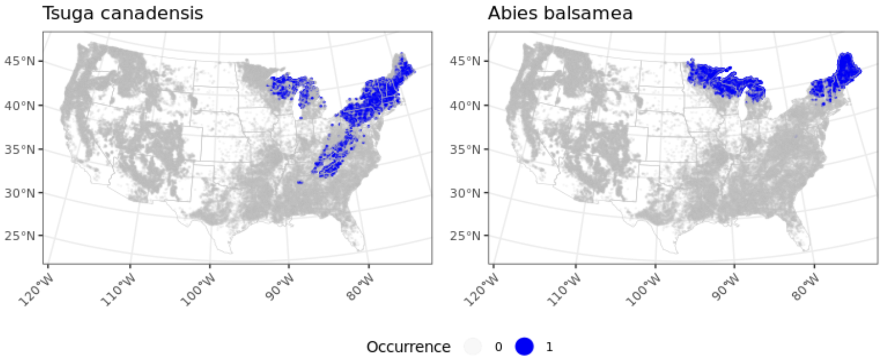
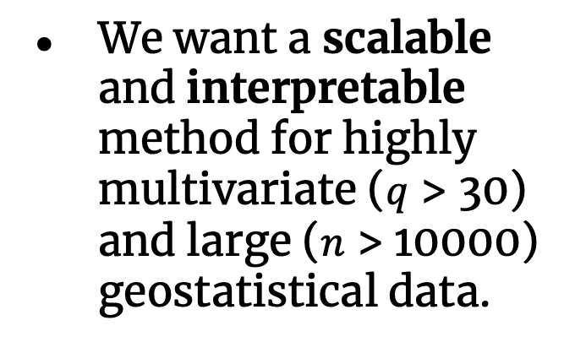
Motivation
Spatial distribution of particle size curves (88 particle sizes, 3340 samples)
Tree species co-occurrence analysis (96 species, 78804 samples)
Air quality monitoring, spatial transcriptomics, spatial proteomics, etc.
We want a scalable and interpretable method for highly multivariate ($q$ > 30) and large ($n$ > 10000) geostatistical data.

Slide 3
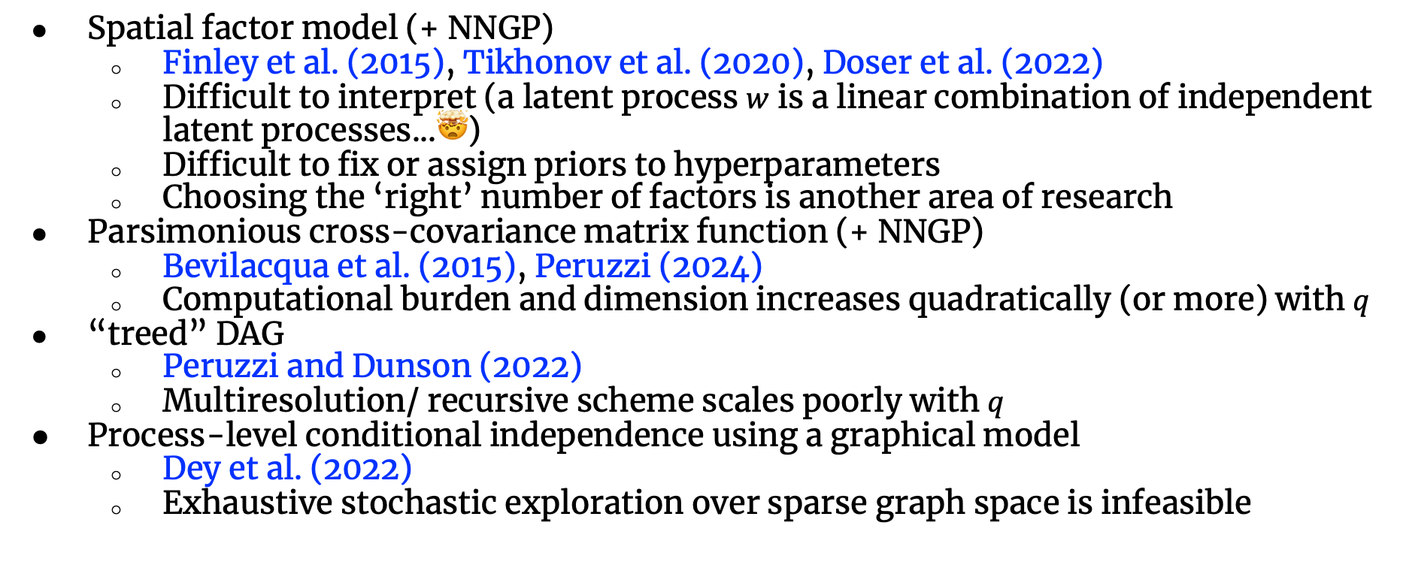
Existing multivariate methods
Spatial factor model (+ NNGP)
Finley et al. (2015), Tikhonov et al. (2020), Doser et al. (2022)
Difficult to interpret (a latent process $w$ is a linear combination of independent latent processes...🤯)
Difficult to fix or assign priors to hyperparameters
Choosing the ‘right’ number of factors is another area of research
Parsimonious cross-covariance matrix function (+ NNGP)
Bevilacqua et al. (2015), Peruzzi (2024)
Computational burden and dimension increases quadratically (or more) with $q$
“treed” DAG
Peruzzi and Dunson (2022)
Multiresolution/ recursive scheme scales poorly with $q$
Process-level conditional independence using a graphical model
Dey et al. (2022)
Exhaustive stochastic exploration over sparse graph space is infeasible
Notes:
Bevilacqua et al. (2015),: tapering

Slide 4
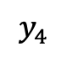
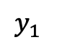
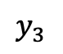
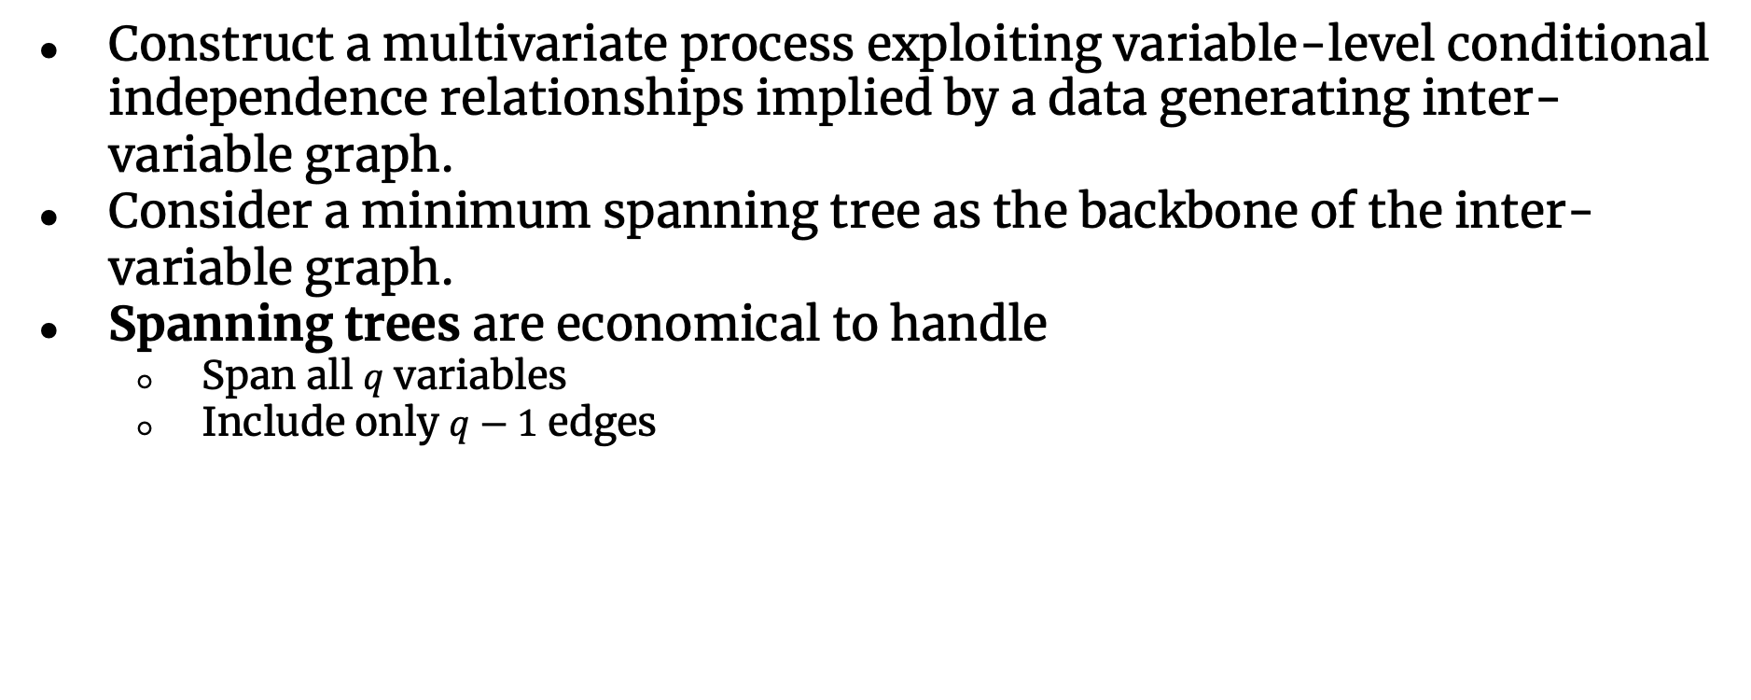
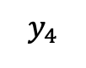
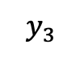
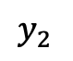
Spanning tree-based approach
Construct a multivariate process exploiting variable-level conditional independence relationships implied by a data generating inter-variable graph.
Consider a minimum spanning tree as the backbone of the inter-variable graph.
Spanning trees are economical to handle
Span all $q$ variables
Include only $q−1$ edges
$$y_{1}$$
$$y_{1}$$
$$y_{2}$$
$$y_{2}$$
$$y_{3}$$
$$y_{4}$$
$$y_{3}$$
$$y_{4}$$

Slide 5
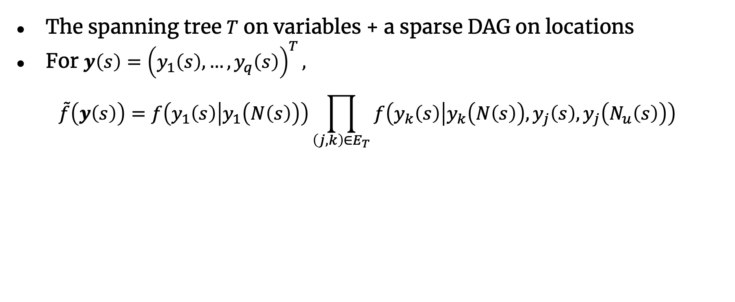
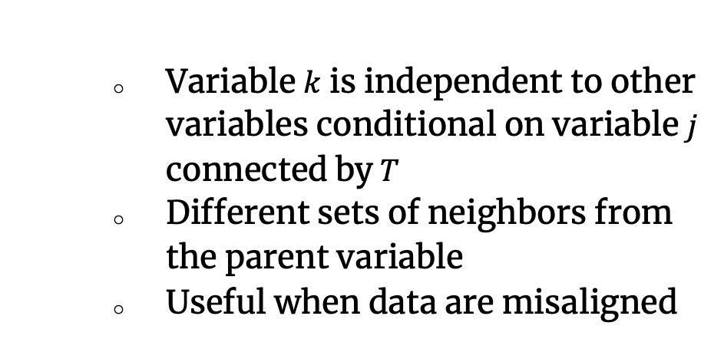
Spanning tree-based approach
The spanning tree $T$ on variables + a sparse DAG on locations
For $y\left(s\right)={\left(y_{1}\left(s\right),…, y_{q}\left(s\right)\right)}^{T},$
$$\tilde{f}\left(y\left(s\right)\right)=f\left(y_{1}\left(s\right) | y_{1}\left(N\left(s\right)\right)\right)\prod_{\left(j,k\right)∈E_{T}}{f\left(y_{k}\left(s\right) | y_{k}\left(N\left(s\right)\right),y_{j}\left(s\right), y_{j}\left(N_{u}\left(s\right)\right)\right)}$$
Variable $k$ is independent to other variables conditional on variable $j$ connected by$T$
Different sets of neighbors from the parent variable
Useful when data are misaligned

Slide 6
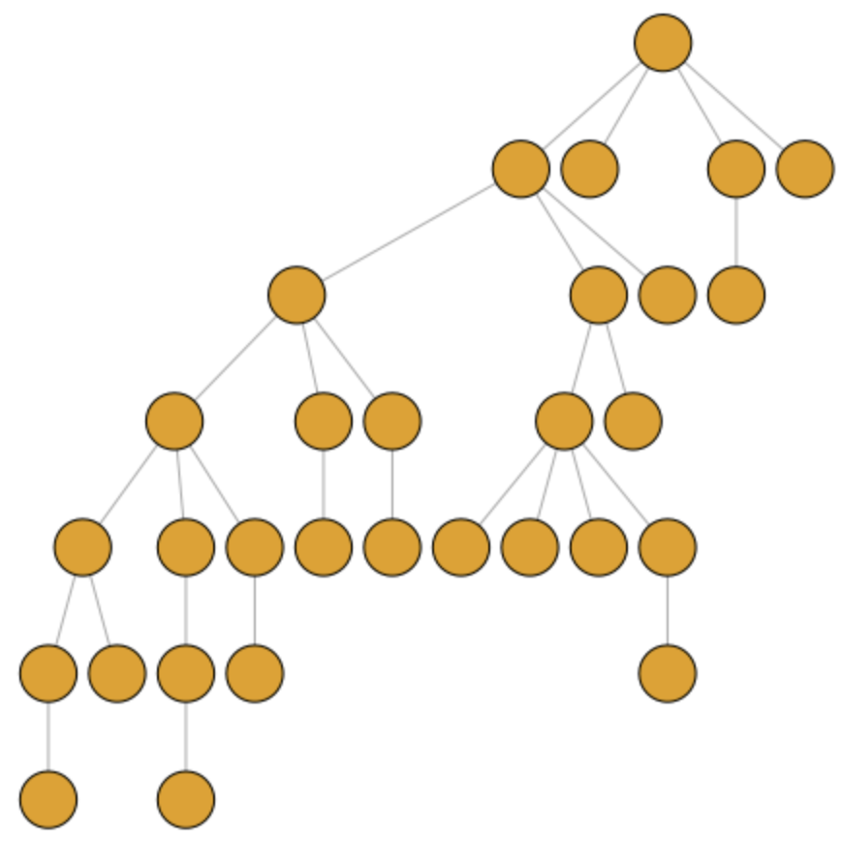
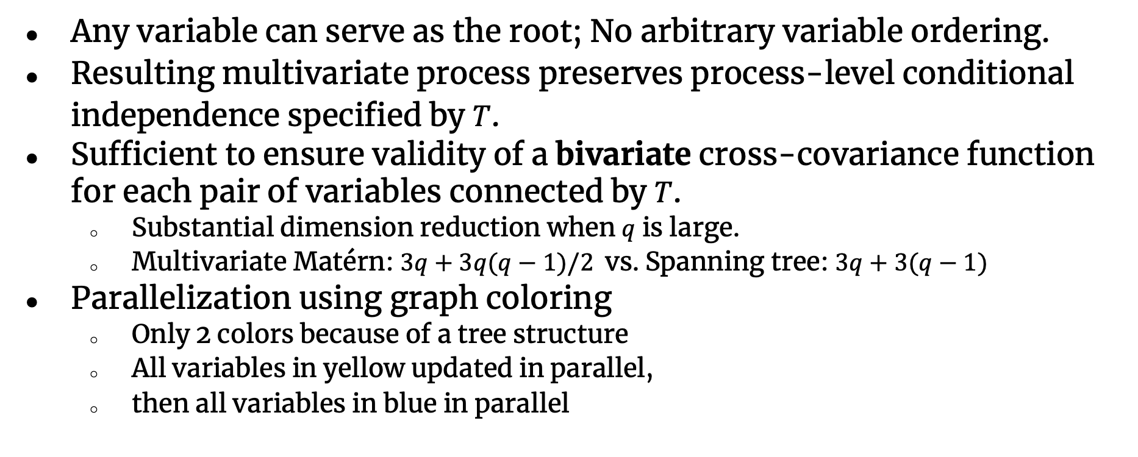
Properties
Any variable can serve as the root; No arbitrary variable ordering.
Resulting multivariate process preserves process-level conditional independence specified by $T$.
Sufficient to ensure validity of a bivariate cross-covariance function for each pair of variables connected by $T$.
Substantial dimension reduction when $q$ is large.
Multivariate Matérn: $3q+3q(q−1)/2$vs. Spanning tree: $3q+3(q−1)$
Parallelization using graph coloring
Only 2 colors because of a tree structure
All variables in yellow updated in parallel,
then all variables in blue in parallel
Notes:
All nodes in yellow in parallel – all nodes in blue in parallel

Slide 7
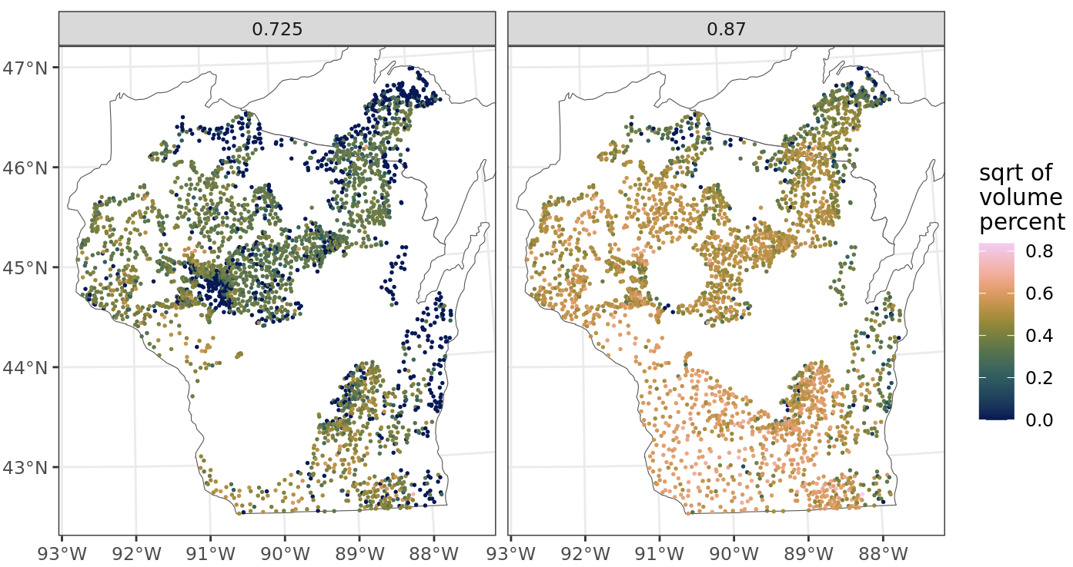
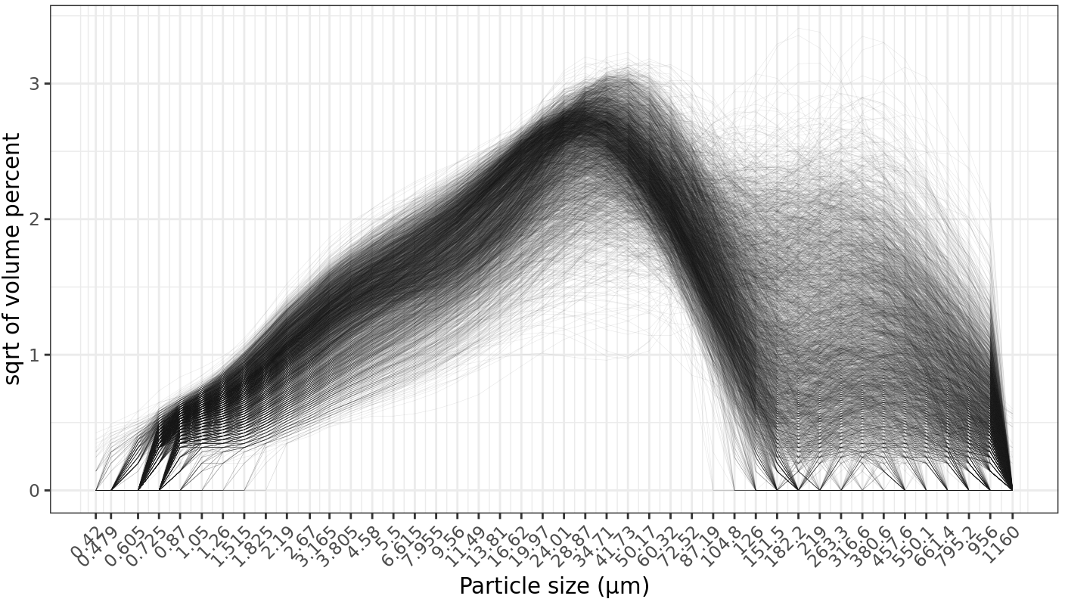
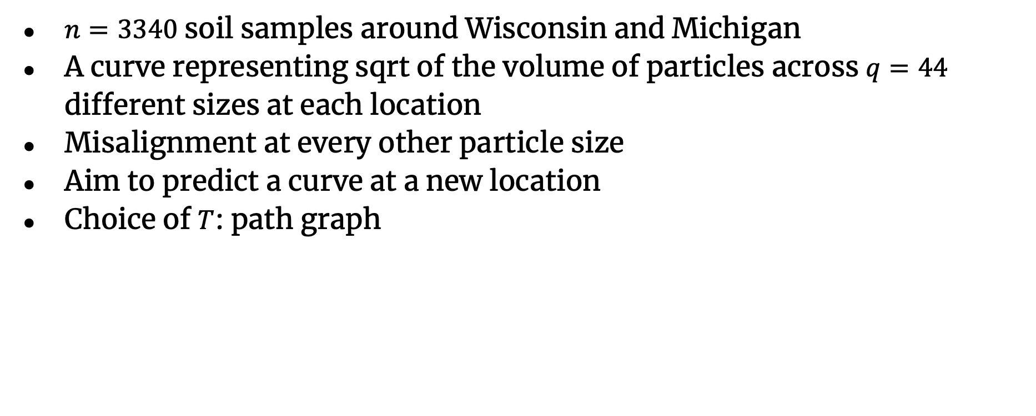
Particle size curves
$n=3340$soil samples around Wisconsin and Michigan
A curve representing sqrt of the volume of particles across $q=44$ different sizes at each location
Misalignment at every other particle size
Aim to predict a curve at a new location
Choice of $T$: path graph
Notes:
to evaluate paleoenvironments of deposition

Slide 8
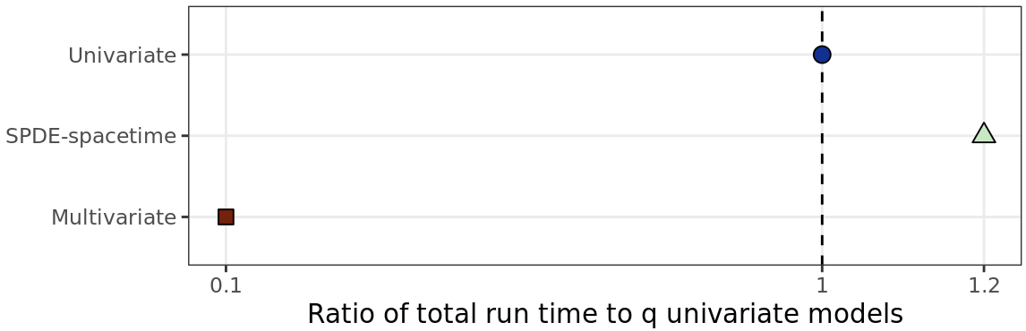
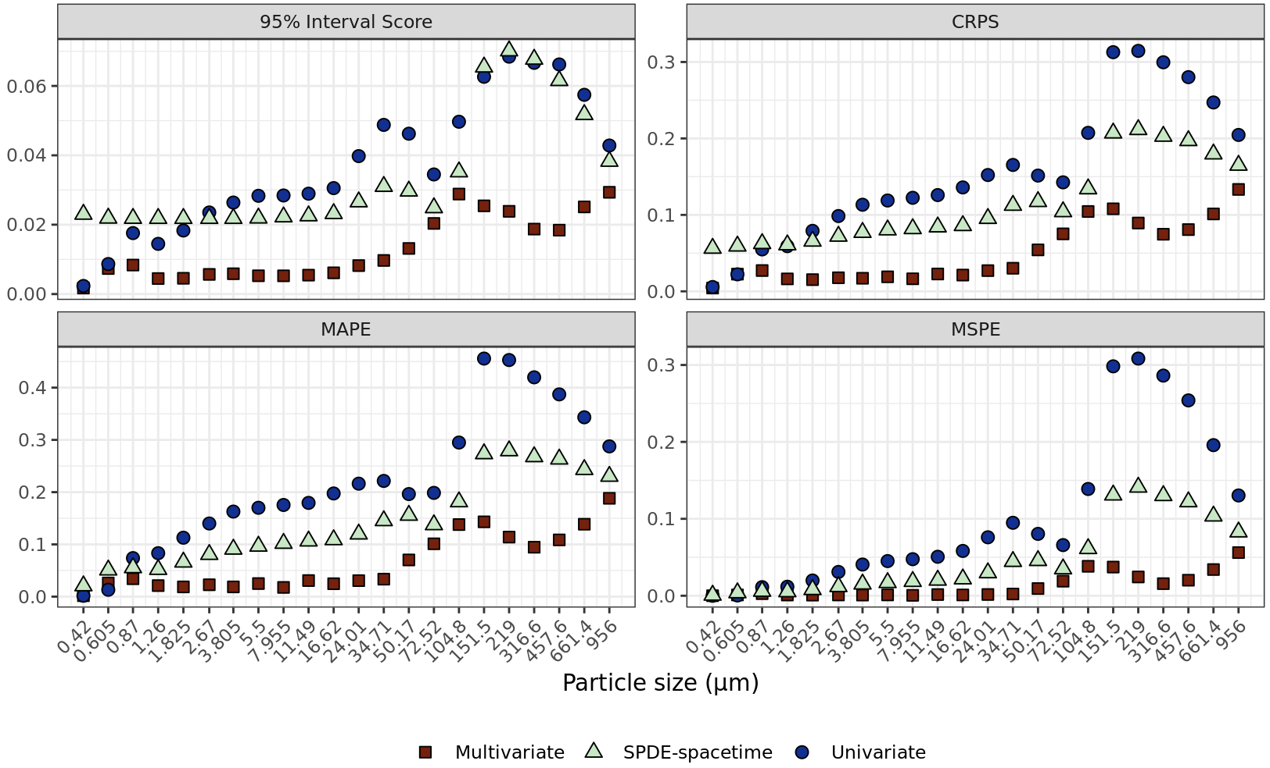
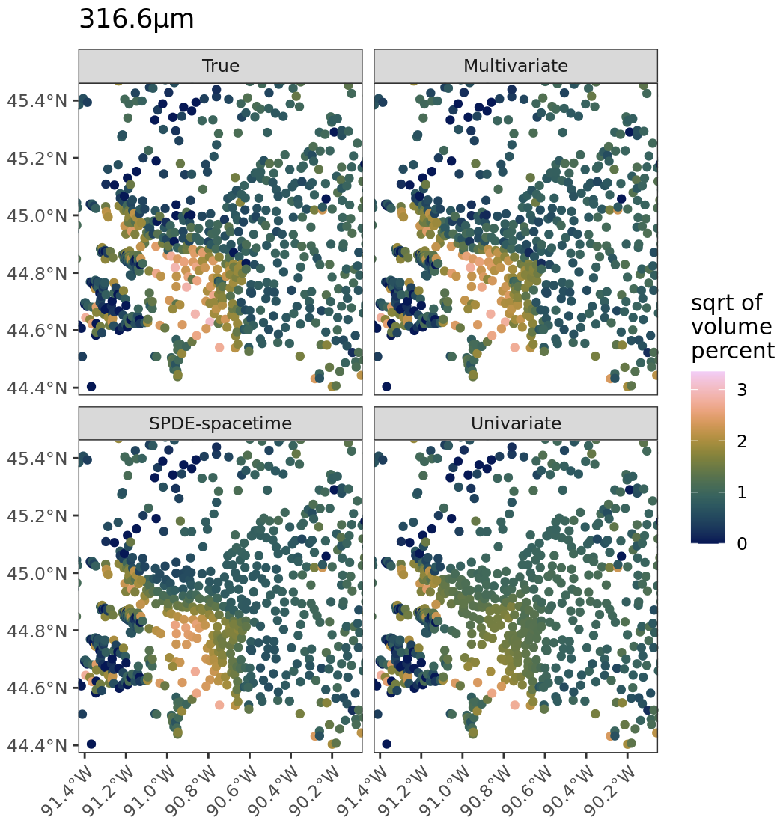
Particle size curves
Reduction in computation time
Gain in prediction accuracy for misaligned locations
Silt dominating area; competitors underestimate volume of coarse particles

Slide 9
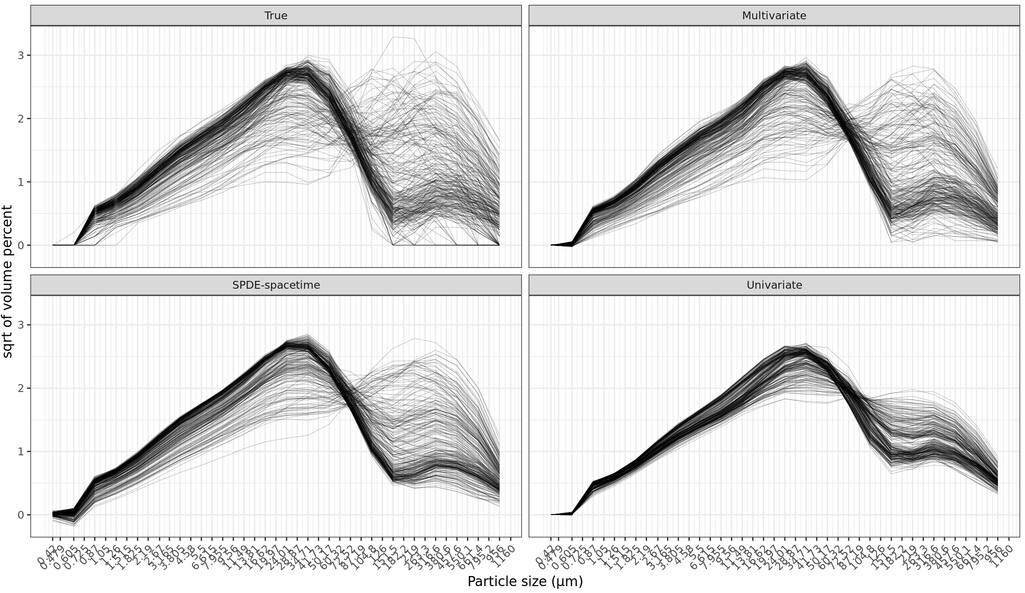
Particle size curves
Separable spacetime model and independent univariate model struggle to find hotspots rich with medium or large sand.

Slide 10
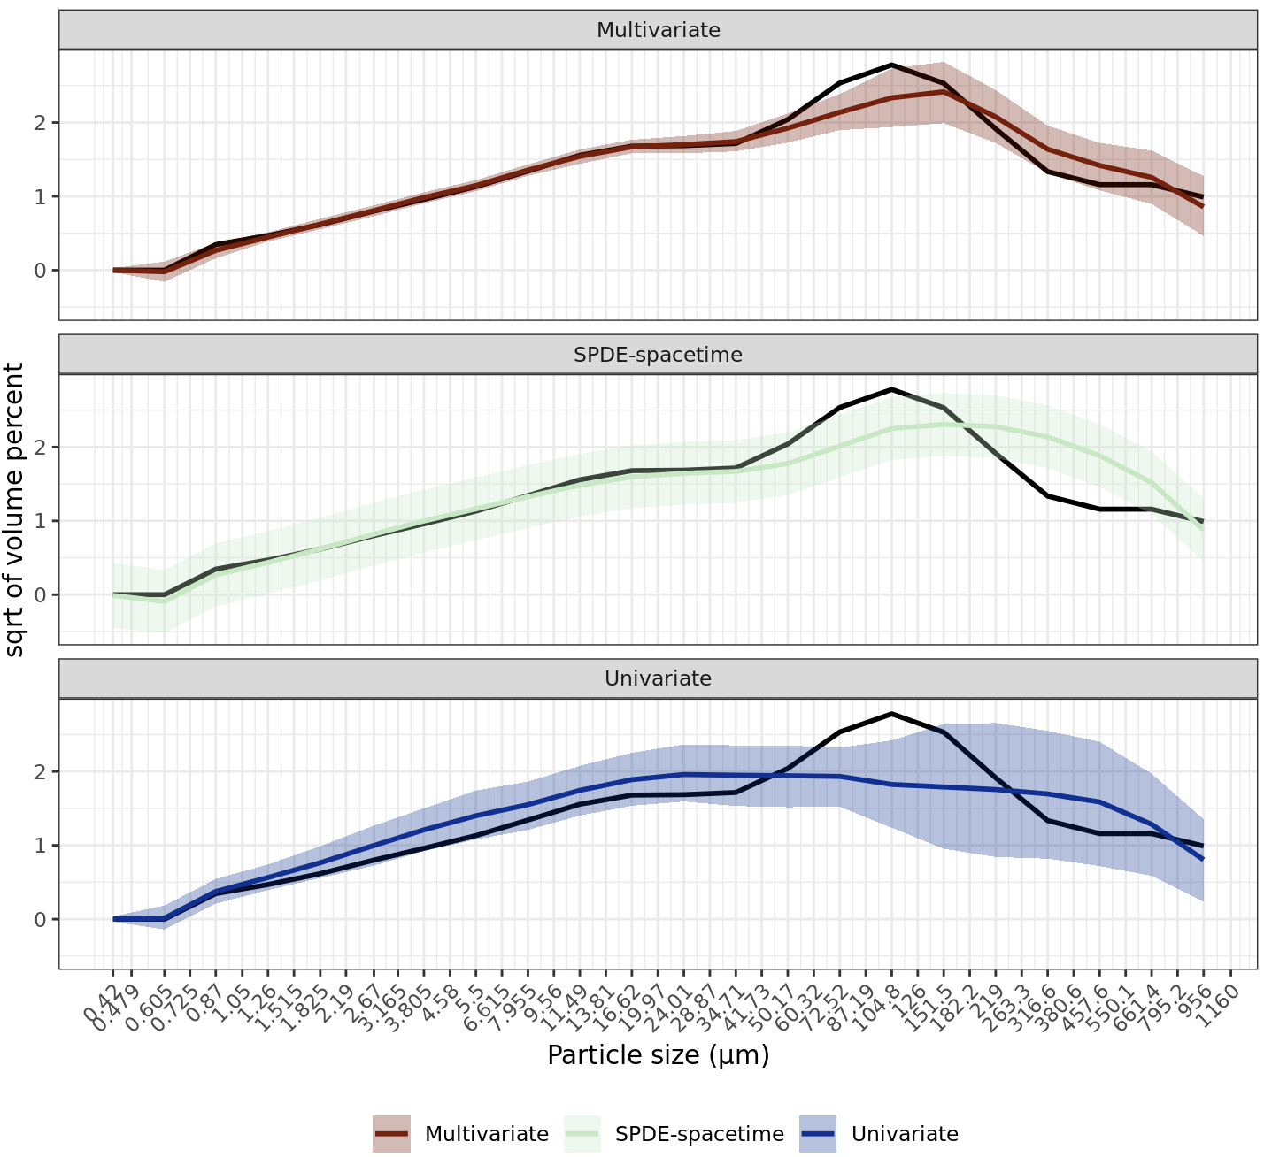
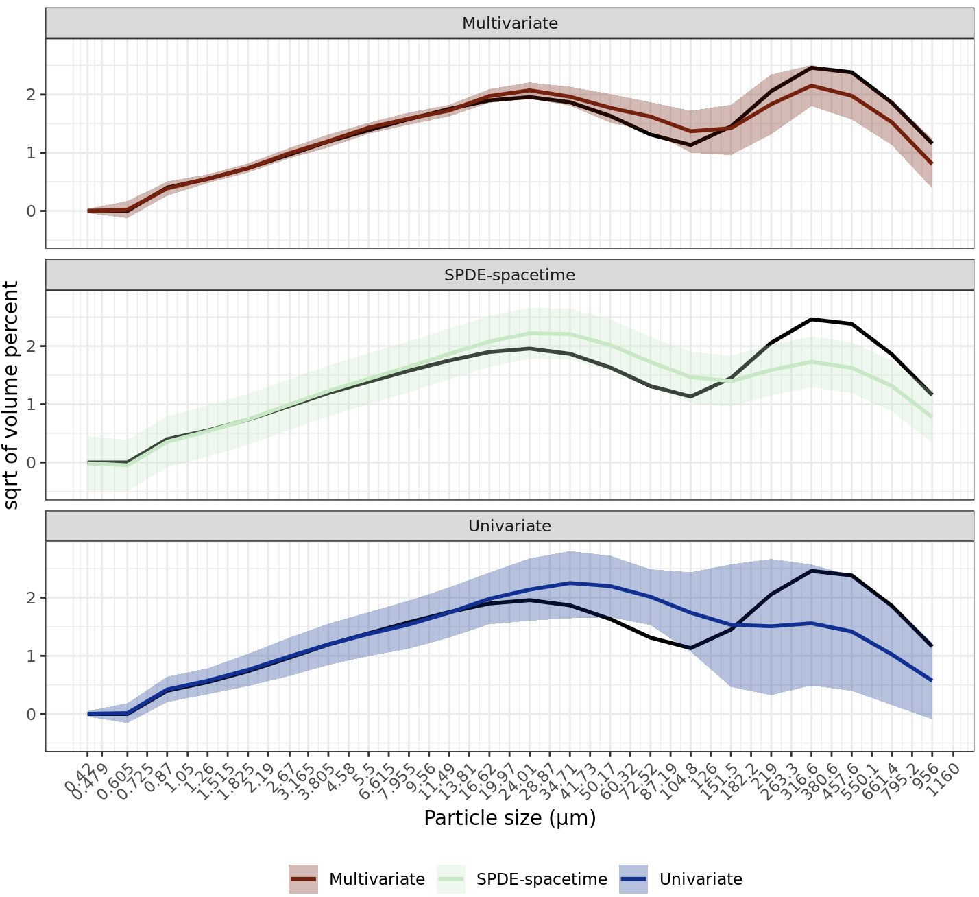
Particle size curves
Separable spacetime model and independent univariate model struggle to find hotspots rich with medium or large sand.

Slide 11
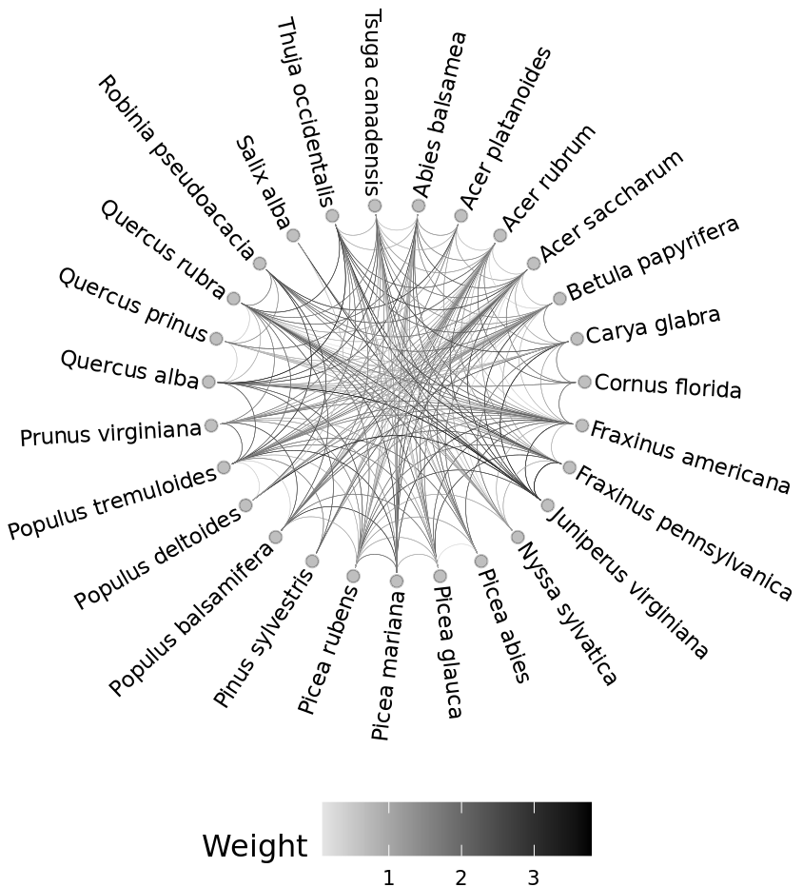
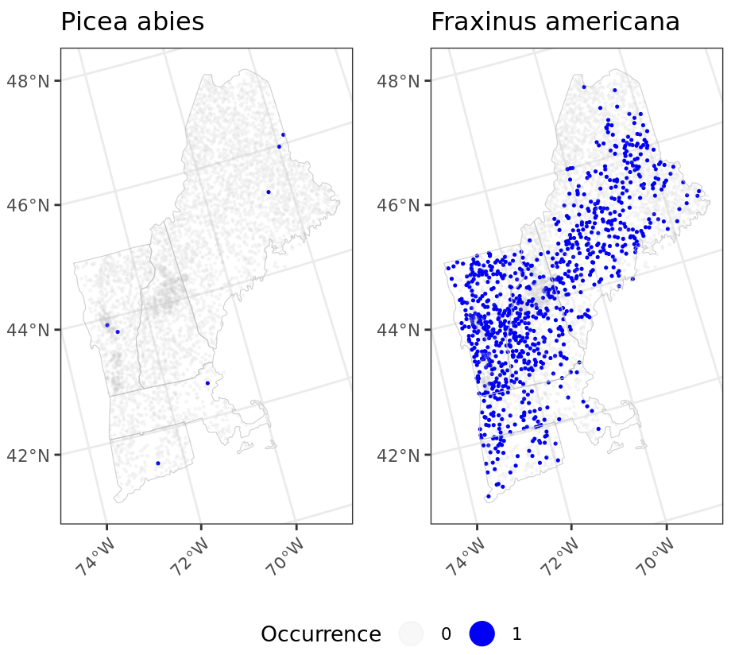
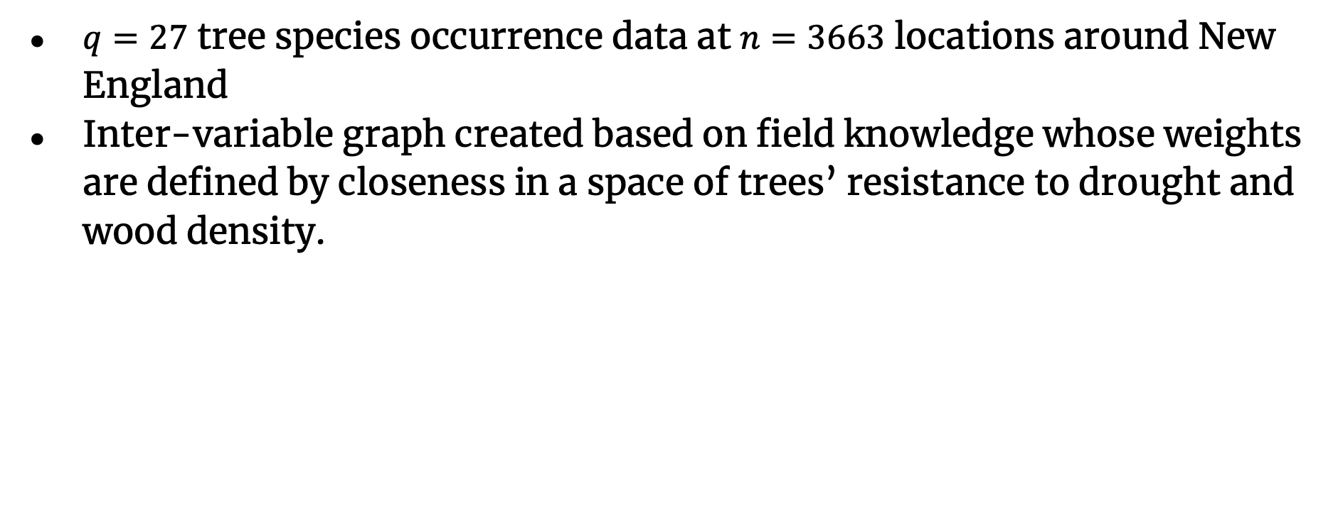
Tree species co-occurrence
$q=27$ tree species occurrence data at $n=3663$ locations around New England
Inter-variable graph created based on field knowledge whose weights are defined by closeness in a space of trees’ resistance to drought and wood density.

Slide 12
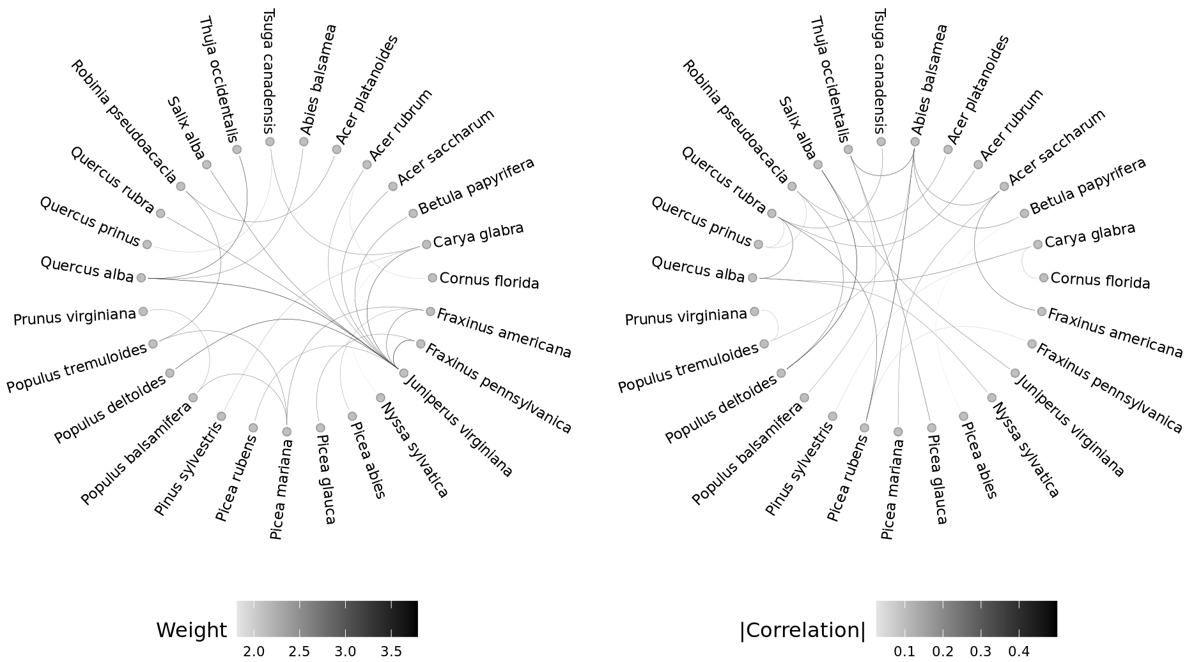
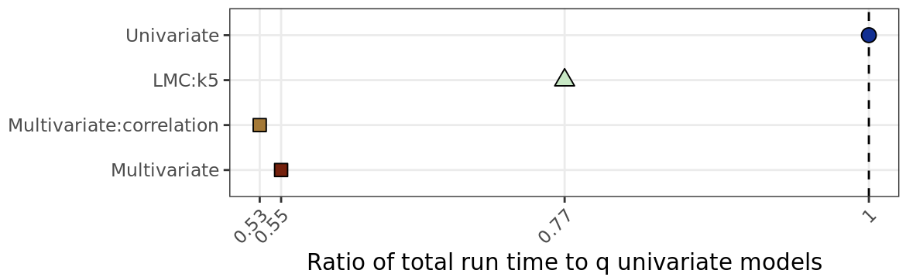
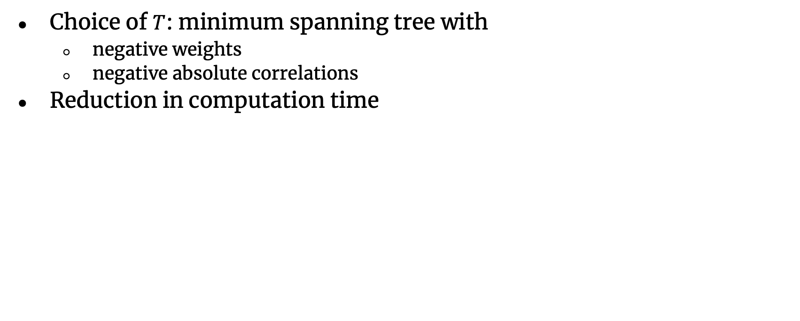
Tree species co-occurrence
Choice of $T$: minimum spanning tree with
negative weights
negative absolute correlations
Reduction in computation time

Slide 13
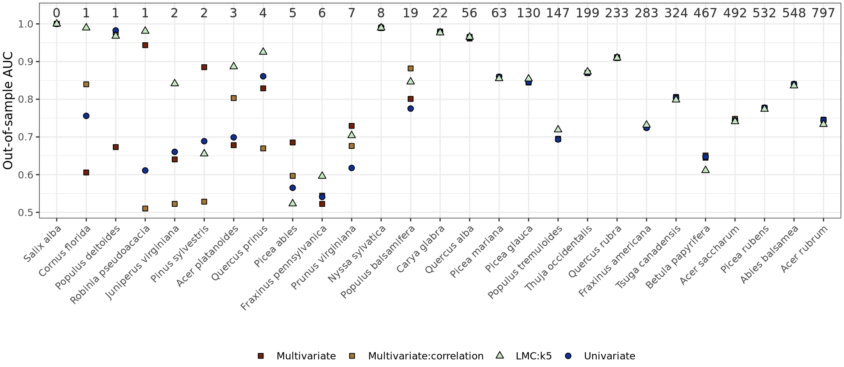
Tree species co-occurrence
Gain in prediction accuracy for moderately rare species
Notes:
Out of 1099

Slide 14
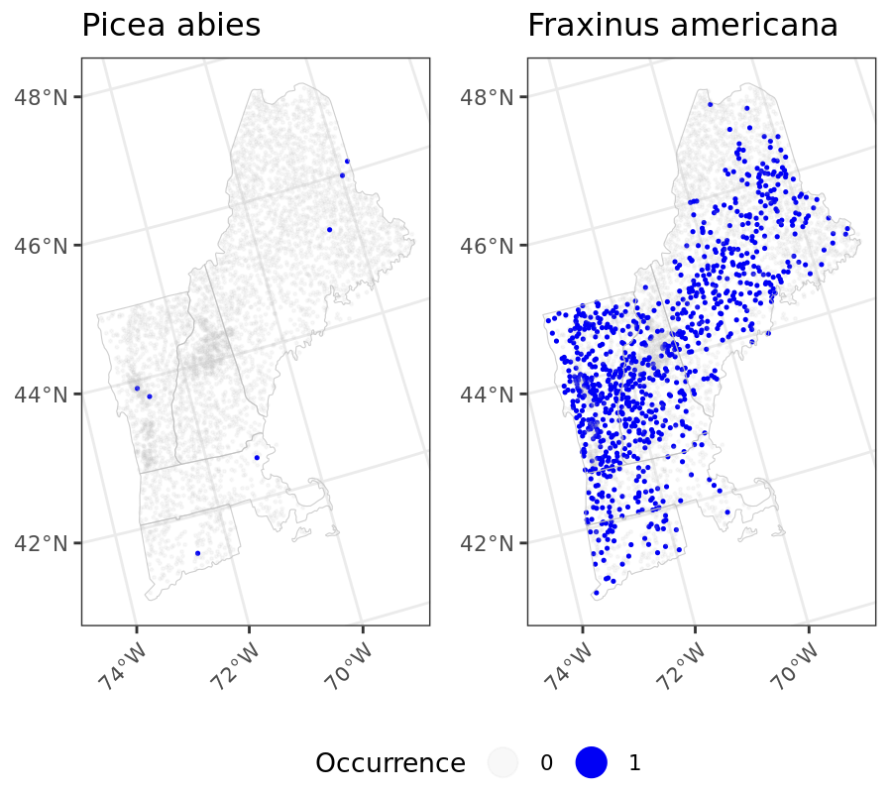
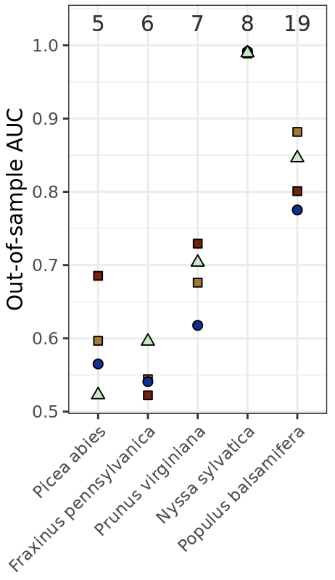
Tree species co-occurrence
Gain in prediction accuracy for moderately rare species

Slide 15
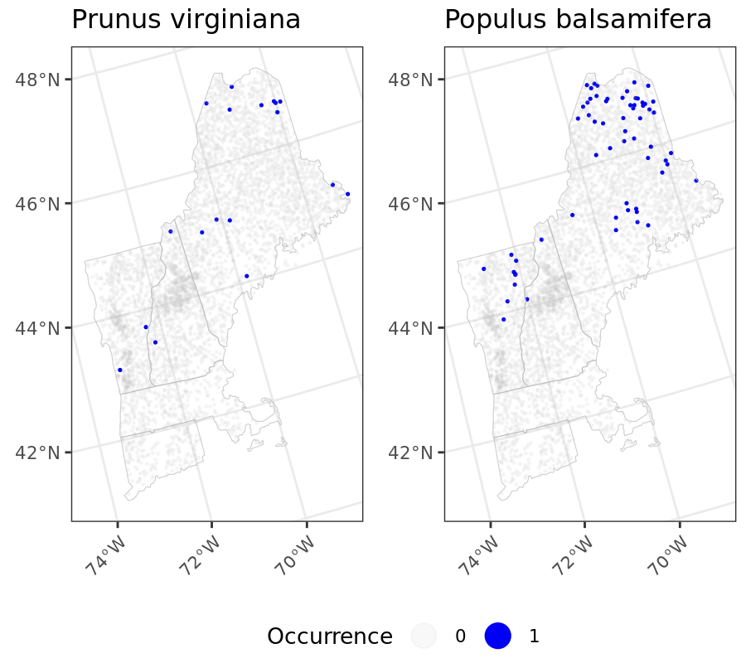
Tree species co-occurrence
Gain in prediction accuracy for moderately rare species

Slide 16
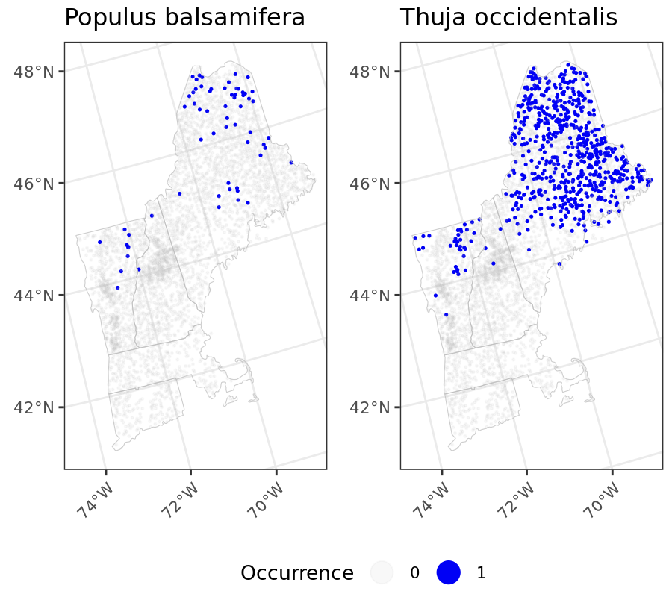
Tree species co-occurrence
Gain in prediction accuracy for moderately rare species

Slide 17
Tree species co-occurrence
Similar prediction performance for frequently observed species

Slide 18
Tree species co-occurrence
Factor model helps the most for extremely rare species
Notes:
Factor model helps the most for extremely rare species

Slide 19
Future direction
Using a minimum spanning tree can be too restrictive; combine results over multiple minimum spanning trees
Choice of a minimum spanning tree can be arbitrary when graph structure is not intrinsic among variables; alternative ways to infer inter-variable relationships?
With fixed covariance parameters, MCMC can be avoided (predictive stacking; Zhang et al. 2023).
Happy to hear your insight/suggestions/feedback!
bjin9@jh.edu

Slide 20
Reference
Bevilacqua, M., Fassò, A., Gaetan, C. et al. Covariance tapering for multivariate Gaussian random fields estimation. Stat Methods Appl 25, 21–37 (2016). https://doi.org/10.1007/s10260-015-0338-3
Dey, D., Datta, A., Banerjee, S. (2022) Graphical Gaussian process models for highly multivariate spatial data, Biometrika, Volume 109, Issue 4, December 2022, Pages 993–1014, https://doi.org/10.1093/biomet/asab061
Doser, J. W., Finley A. O., Kéry, M., & Zipkin E. F. (2022). spOccupancy: An R package for single-species, multi-species, and integrated spatial occupancy models Methods in Ecology and Evolution, 13, 1670-1678. https://doi.org/10.1111/2041-210X.13897
Finley, A. O., Banerjee, S., & Gelfand, A. E. (2015). spBayes for Large Univariate and Multivariate Point-Referenced Spatio-Temporal Data Models. Journal of Statistical Software, 63(13), 1–28. https://doi.org/10.18637/jss.v063.i13
Peruzzi, M., & Dunson, D. B. (2022). Spatial Multivariate Trees for Big Data Bayesian Regression. Journal of machine learning research : JMLR, 23, 17.
Peruzzi, M. (2024). Inside-out cross-covariance for spatial multivariate data. arXiv preprint arXiv:2412.12407.
Tikhonov, G., Opedal, Ø. H., Abrego, N., Lehikoinen, A., de Jonge, M. M. J., Oksanen, J., & Ovaskainen, O. (2020). Joint species distribution modelling with the r-package Hmsc. Methods in ecology and evolution, 11(3), 442–447. https://doi.org/10.1111/2041-210X.13345
Zhang, L., Tang, W., Banerjee, S. (2023). Bayesian Geostatistics Using Predictive Stacking. arXiv preprint arXiv:2304.12414.

